Slide 1
SENG 1000 - Software Engineering Foundations and Practice
-Sumati

Slide 2
Topics
Introduction to Value-returning Functions: Generating Random Numbers
Writing Your Own Value-Returning Functions
The math Module
Storing Functions in Modules

Slide 3
Introduction to Value-Returning Functions: Generating Random Numbers
Simple function: group of statements within a program for performing a specific task
Call function when you need to perform the task
Value-returning function: similar to simple function, returns a value
Value returned to part of program that called the function when function finishes executing

Slide 4
Standard Library Functions and the import Statement
Standard library: library of pre-written functions that comes with Python
Library functions perform tasks that programmers commonly need
Example: print, input, range
Viewed by programmers as a “black box”
Some library functions built into Python interpreter
To use, just call the function

Slide 5
Standard Library Functions and the import Statement (cont’d.)
Modules: files that stores functions of the standard library
Help organize library functions not built into the interpreter
Copied to computer when you install Python
To call a function stored in a module, need to write an import statement
Written at the top of the program
Format: import module_name

Slide 6

Standard Library Functions and the import Statement (cont’d.)

Slide 7
Generating Random Numbers
Random number are useful in a lot of programming tasks
random module: includes library functions for working with random numbers
Dot notation: notation for calling a function belonging to a module
Format: module_name.function_name()

Slide 8
Generating Random Numbers (cont’d.)
randint function: generates a random number in the range provided by the arguments
Returns the random number to part of program that called the function
Returned integer can be used anywhere that an integer would be used
You can experiment with the function in interactive mode

Slide 9
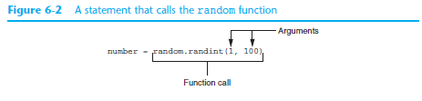
Generating Random Numbers (cont’d.)

Slide 10
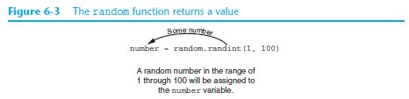
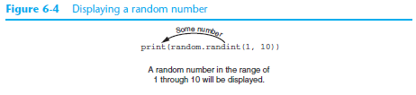
Generating Random Numbers (cont’d.)

Slide 11
Generating Random Numbers (cont’d.)
randrange function: similar to range function, but returns randomly selected integer from the resulting sequence
Same arguments as for the range function
random function: returns a random float in the range of 0.0 and 1.0
Does not receive arguments
uniform function: returns a random float but allows user to specify range

Slide 12
Random Number Seeds
Random number created by functions in random module are actually pseudo-random numbers
Seed value: initializes the formula that generates random numbers
Need to use different seeds in order to get different series of random numbers
By default uses system time for seed
Can use random.seed() function to specify desired seed value

Slide 13
Writing Your Own Value-Returning Functions
To write a value-returning function, you write a simple function and add one or more return statements
Format: return expression
The value for expression will be returned to the part of the program that called the function
The expression in the return statement can be a complex expression, such as a sum of two variables or the result of another value- returning function

Slide 14
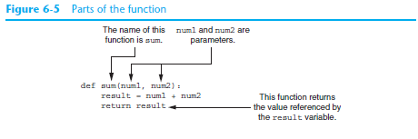
Writing Your Own Value-Returning Functions (cont’d.)

Slide 15
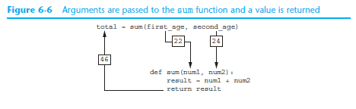
Writing Your Own Value-Returning Functions (cont’d.)

Slide 16
How to Use Value-Returning Functions
Value-returning function can be useful in specific situations
Example: have function prompt user for input and return the user’s input
Simplify mathematical expressions
Complex calculations that need to be repeated throughout the program
Use the returned value
Assign it to a variable or use as an argument in another function

Slide 17
Using IPO Charts
IPO chart: describes the input, processing, and output of a function
Tool for designing and documenting functions
Typically laid out in columns
Usually provide brief descriptions of input, processing, and output, without going into details
Often includes enough information to be used instead of a flowchart

Slide 18
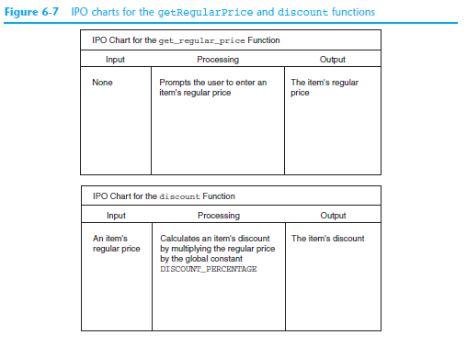
Using IPO Charts (cont’d.)

Slide 19
Returning Boolean Values
Boolean function: returns either True or False
Use to test a condition such as for decision and repetition structures
Common calculations, such as whether a number is even, can be easily repeated by calling a function
Use to simplify complex input validation code

Slide 20
Returning Multiple Values
In Python, a function can return multiple values
Specified after the return statement separated by commas
Format: return expression1,
expression2, etc.
When you call such a function in an assignment statement, you need a separate variable on the left side of the = operator to receive each returned value

Slide 21
The math Module
math module: part of standard library that contains functions that are useful for performing mathematical calculations
Typically accept one or more values as arguments, perform mathematical operation, and return the result
Use of module requires an import math statement

Slide 22
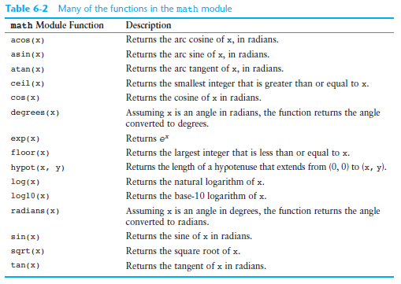
The math Module (cont’d.)

Slide 23
The math Module (cont’d.)
The math module defines variables pi and e, which are assigned the mathematical values for pi and e
Can be used in equations that require these values, to get more accurate results
Variables must also be called using the dot notation
Example:
circle_area = math.pi * radius**2

Slide 24
Storing Functions in Modules
In large, complex programs, it is important to keep code organized
Modularization: grouping related functions in modules
Makes program easier to understand, test, and maintain
Make it easier to reuse code for multiple different programs
Import the module containing the required function to each program that needs it

Slide 25
Storing Functions in Modules (cont’d.)
Module is a file that contains Python code
Contains function definition but does not contain calls to the functions
Importing programs will call the functions
Rules for module names:
File name should end in .py
Cannot be the same as a Python keyword
Import module using import statement

Slide 26
Menu Driven Programs
Menu-driven program: displays a list of operations on the screen, allowing user to select the desired operation
List of operations displayed on the screen is called a menu
Program uses a decision structure to determine the selected menu option and required operation
Typically repeats in loop till user quits

Slide 27
Summary
This chapter covered:
Value-returning functions, including:
Writing value-returning functions
Using value-returning functions
Functions returning multiple values
Using library functions and the import statement
Modules, including:
The random and math modules
Grouping your own functions in modules

